Slide 1
Automating AWS with Ansible
Using Playbooks for Resource Management and Application Hosting

Slide 2
Introduction to Ansible
• Ansible is an open-source automation tool.
• Simplifies configuration management, application deployment, and task automation.
• Ideal for managing cloud resources like AWS.

Slide 3
AWS Resource Management Methods
1. Using Playbook Scripts
2. Inline Variables
3. Outline Variables
Each method involves creating, managing, and deleting AWS resources via Ansible.

Slide 4
Method-1: Using Playbook Scripts
• Launch an instance with Amazon Linux.
• Configure Ansible (hosts and ansible.cfg).
• Install boto, boto3, and botocore libraries.
• Write YAML playbook scripts to:
- Create AWS resources.
- Deploy applications (static/dynamic).
• Execute playbooks with ansible-playbook command.

Slide 5
Static and Dynamic Application Hosting
• Use userdata scripts to deploy applications:
- Static (e.g., hosting a static HTML site).
- Dynamic (e.g., deploying a web application).
• Scripts executed during instance initialization.

Slide 6
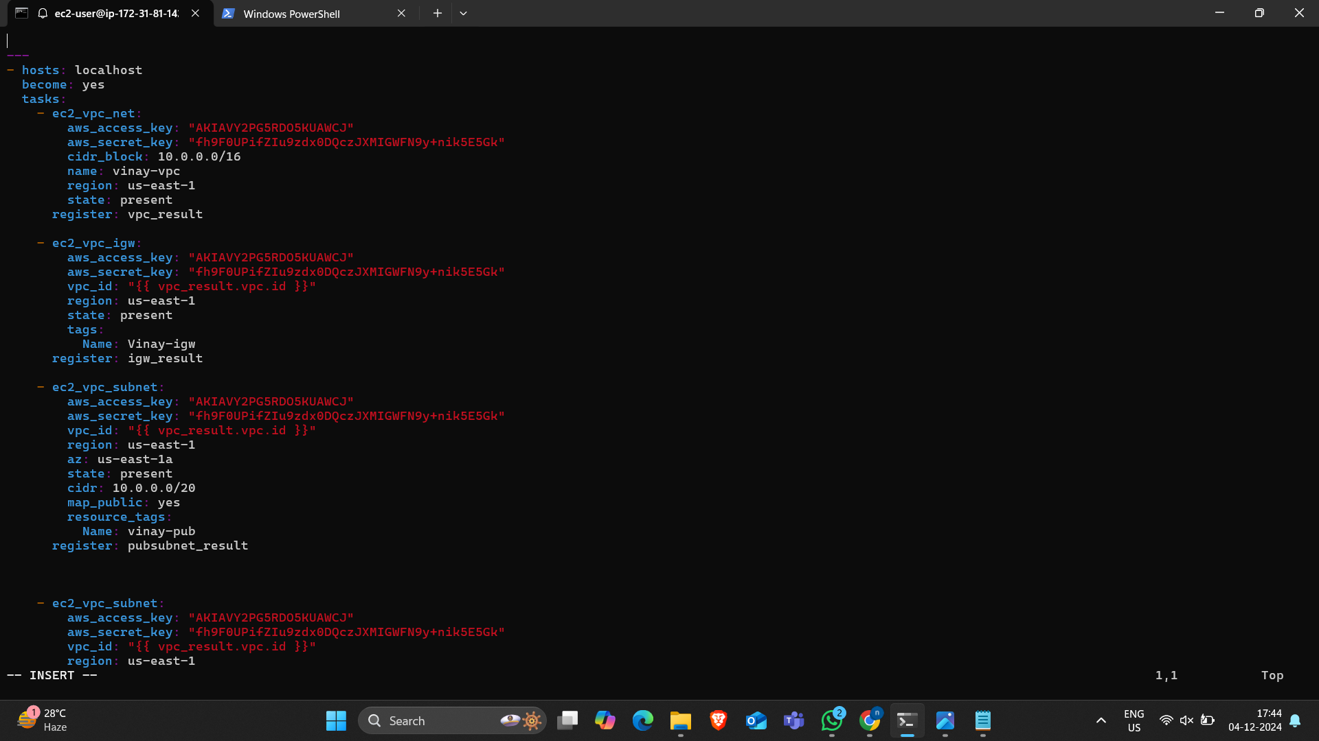
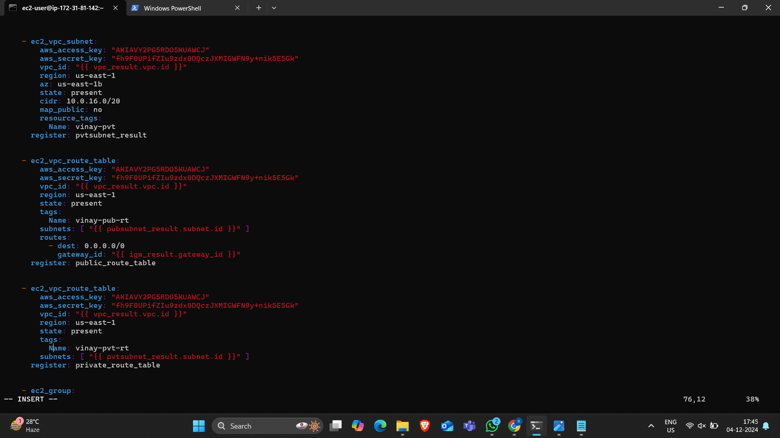
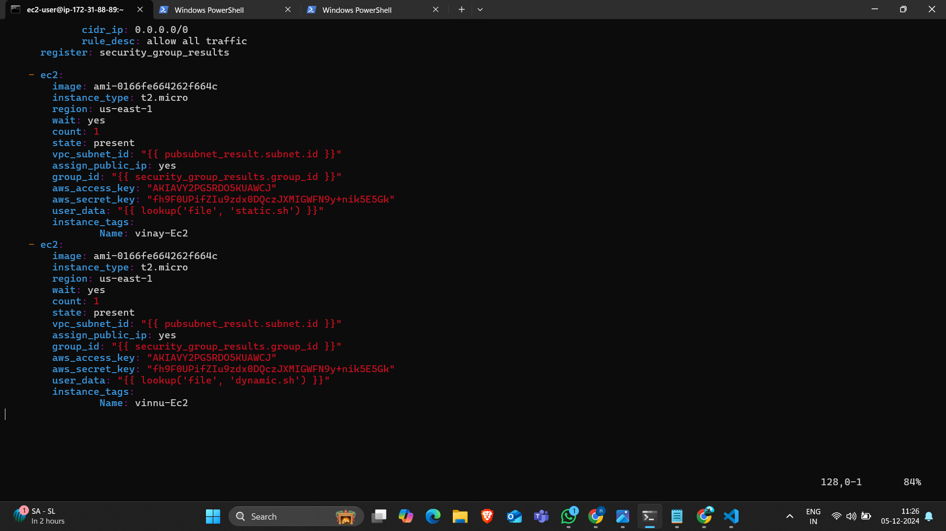
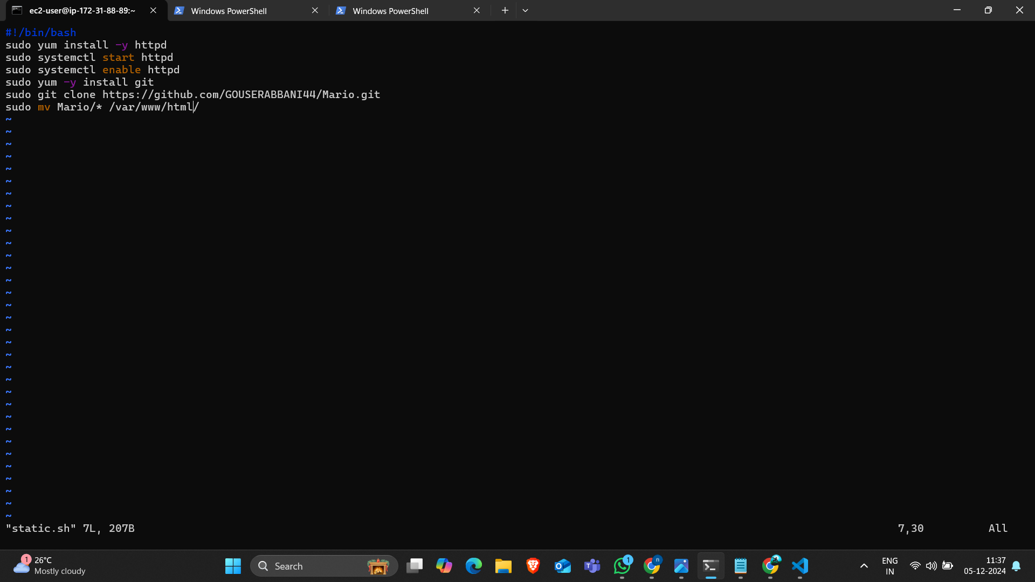
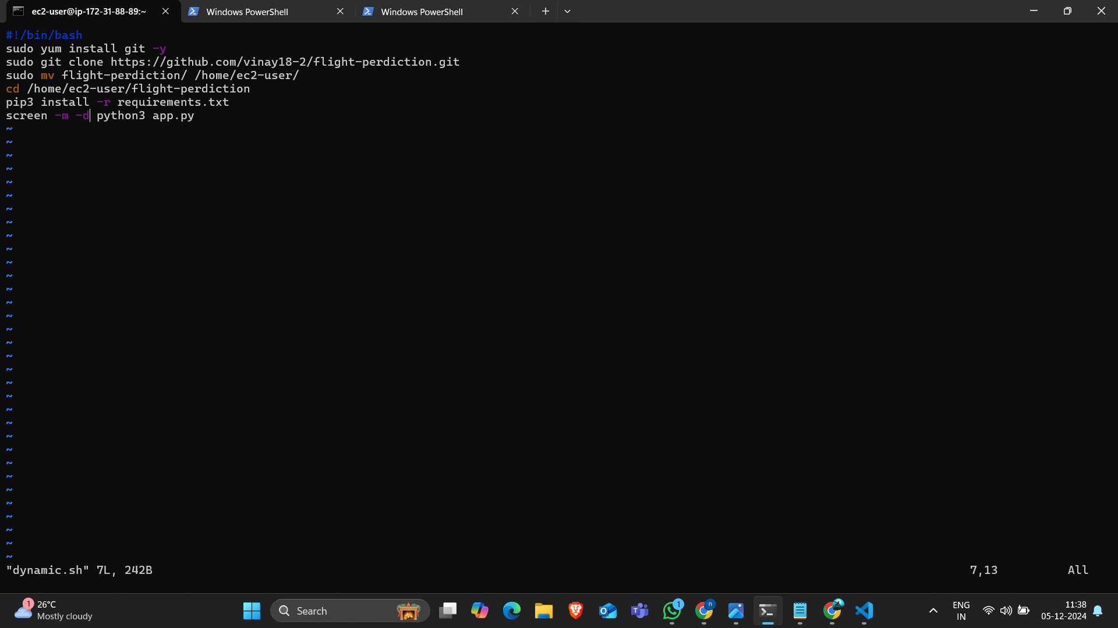
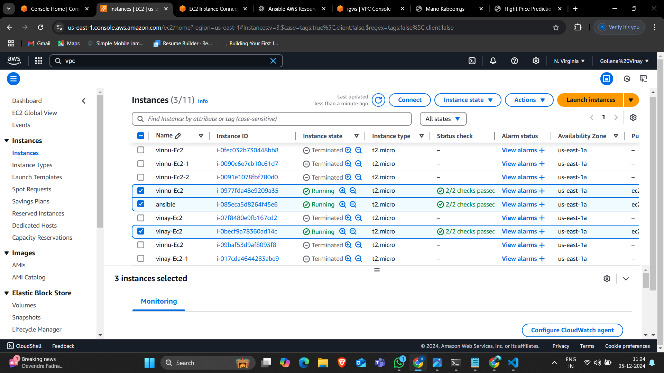
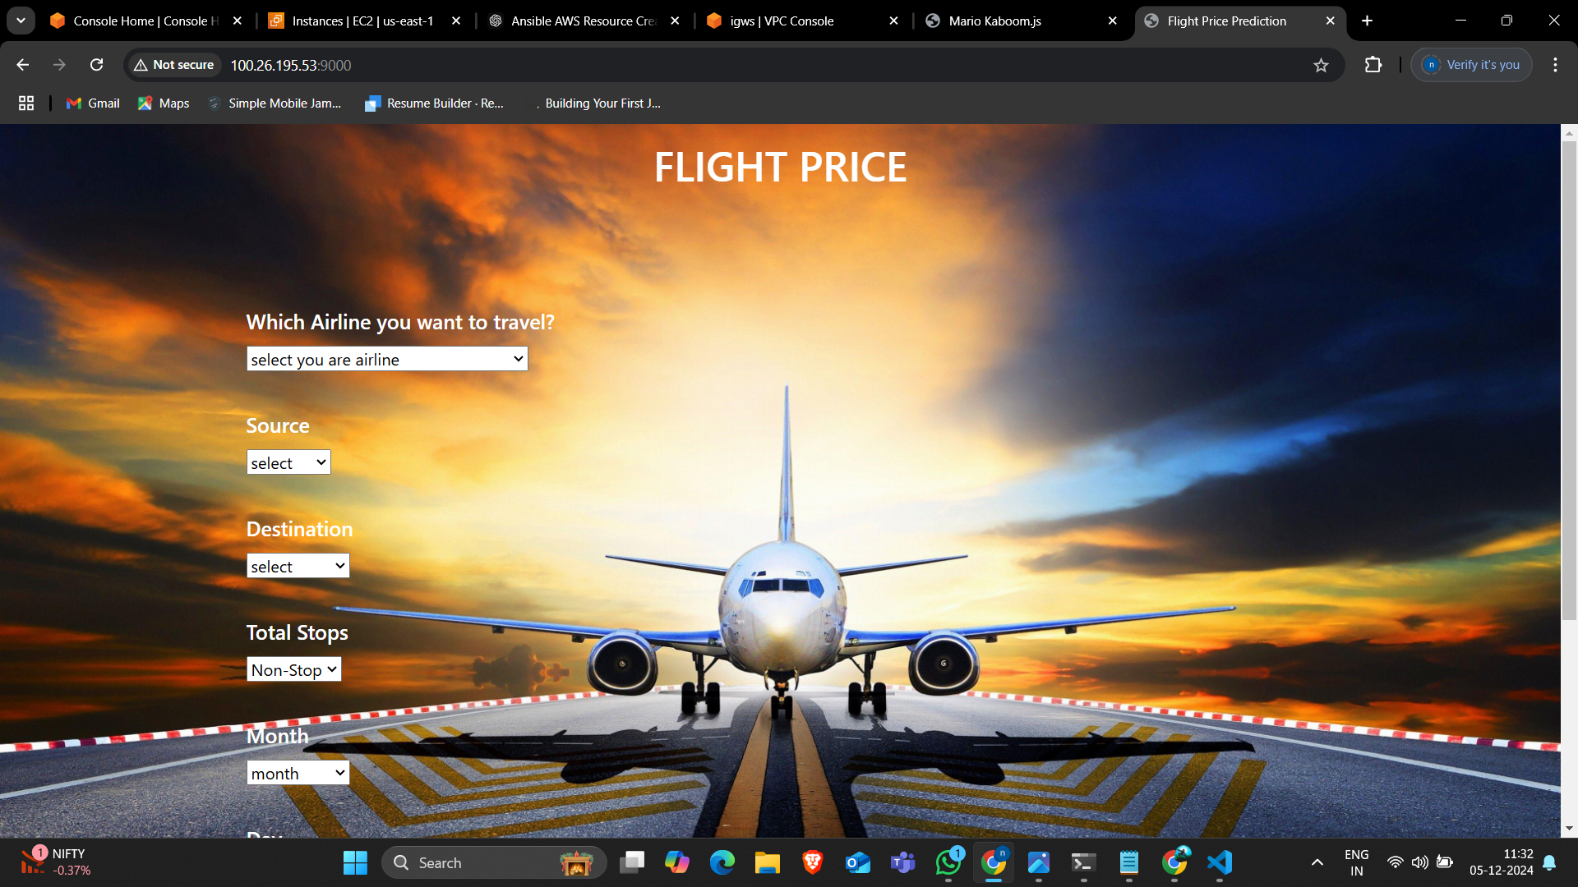
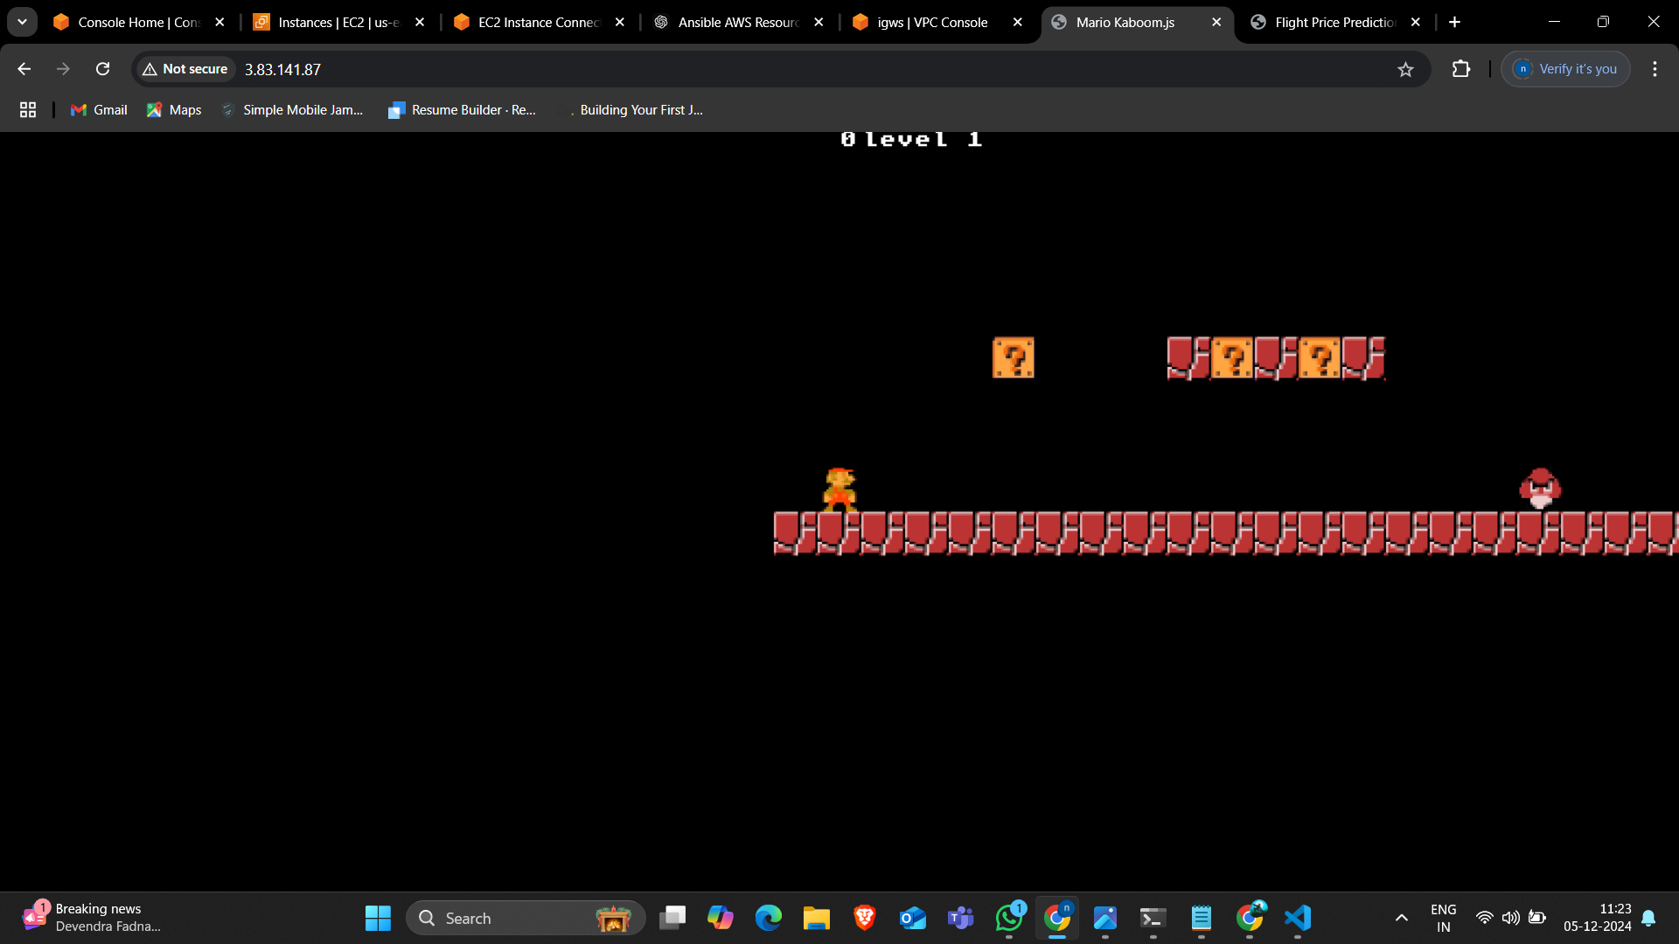
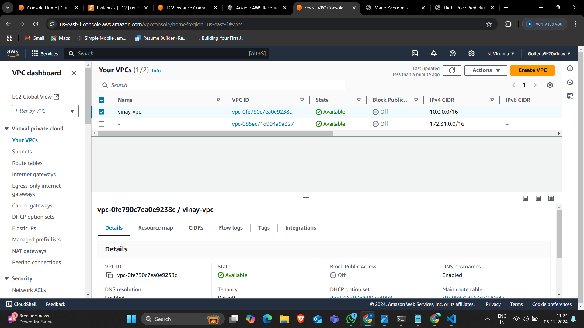

Slide 7
Method-2: Using Inline Variables
• Similar to Method-1 but with inline variables in playbooks.
• Embed variables directly in the YAML script.
• Suitable for simple setups and quick configurations.

Slide 8
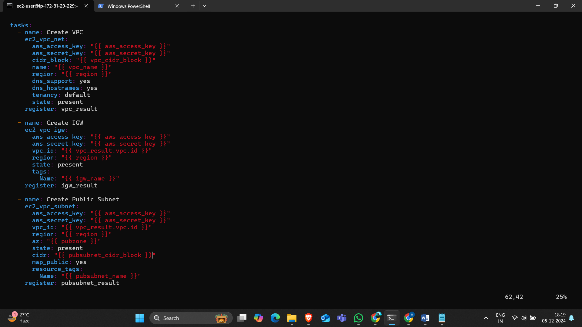
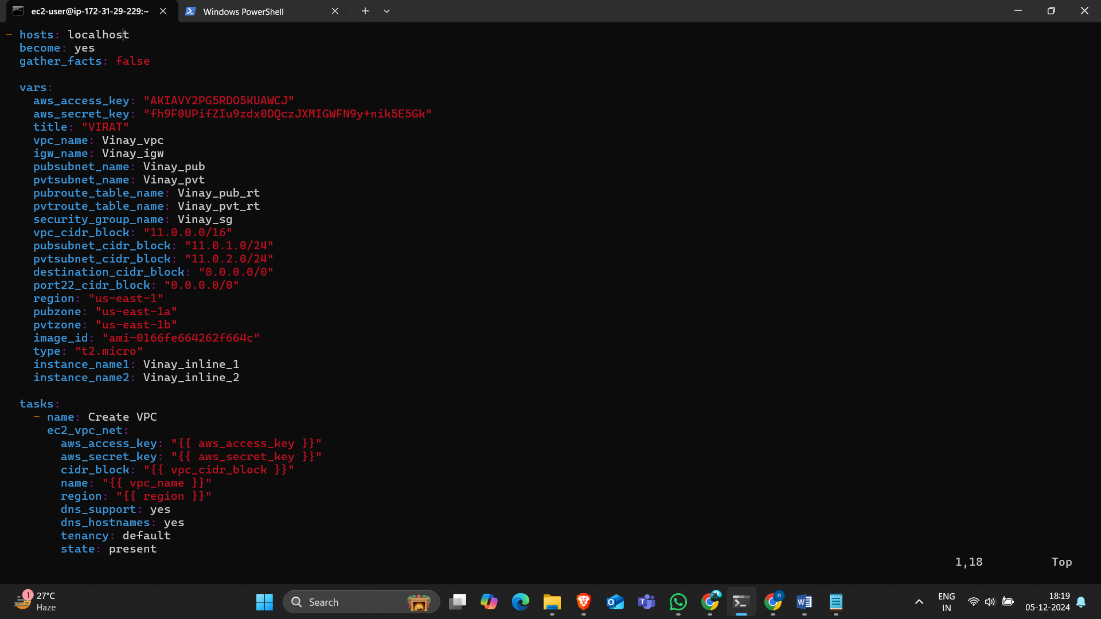
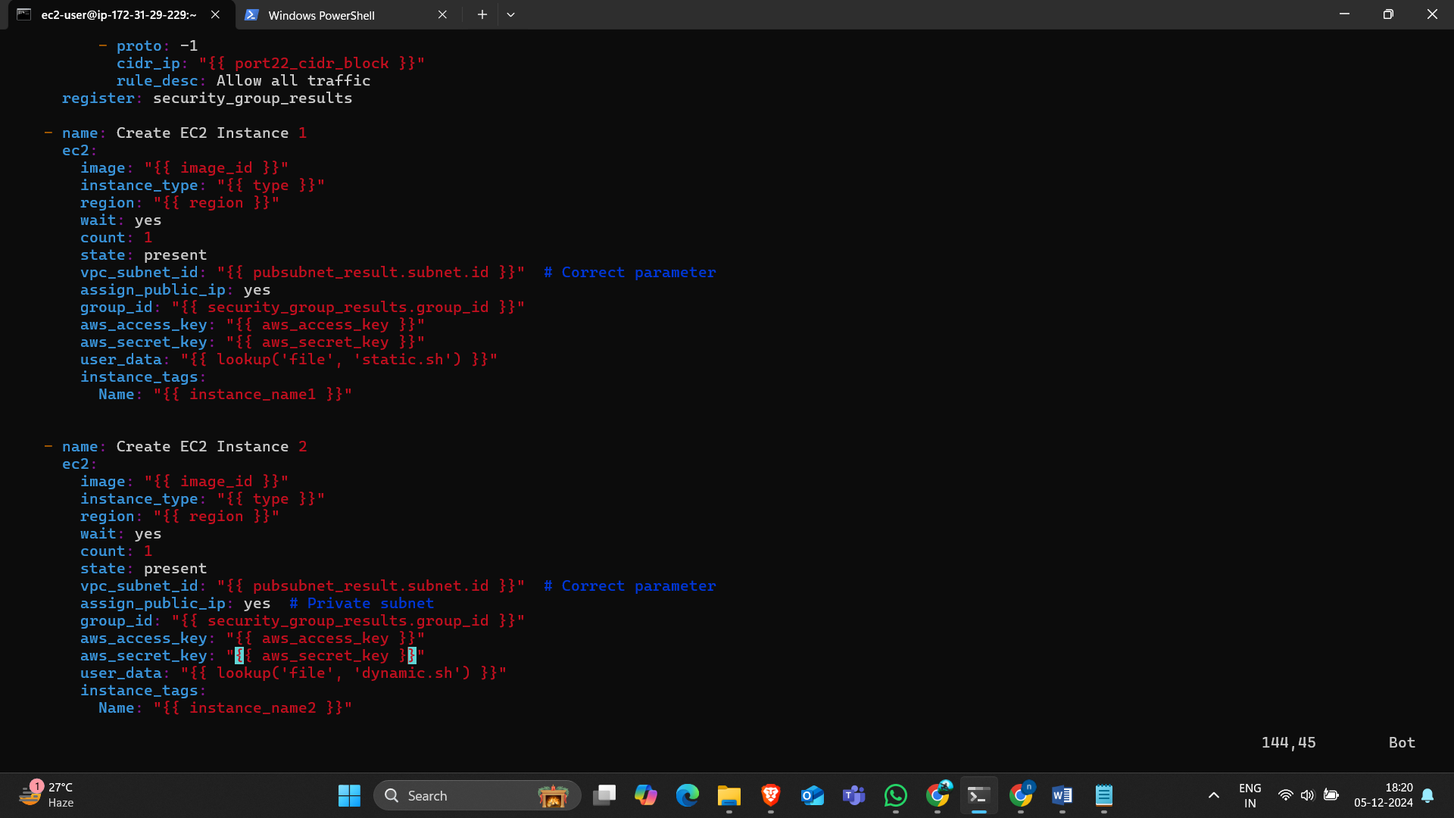
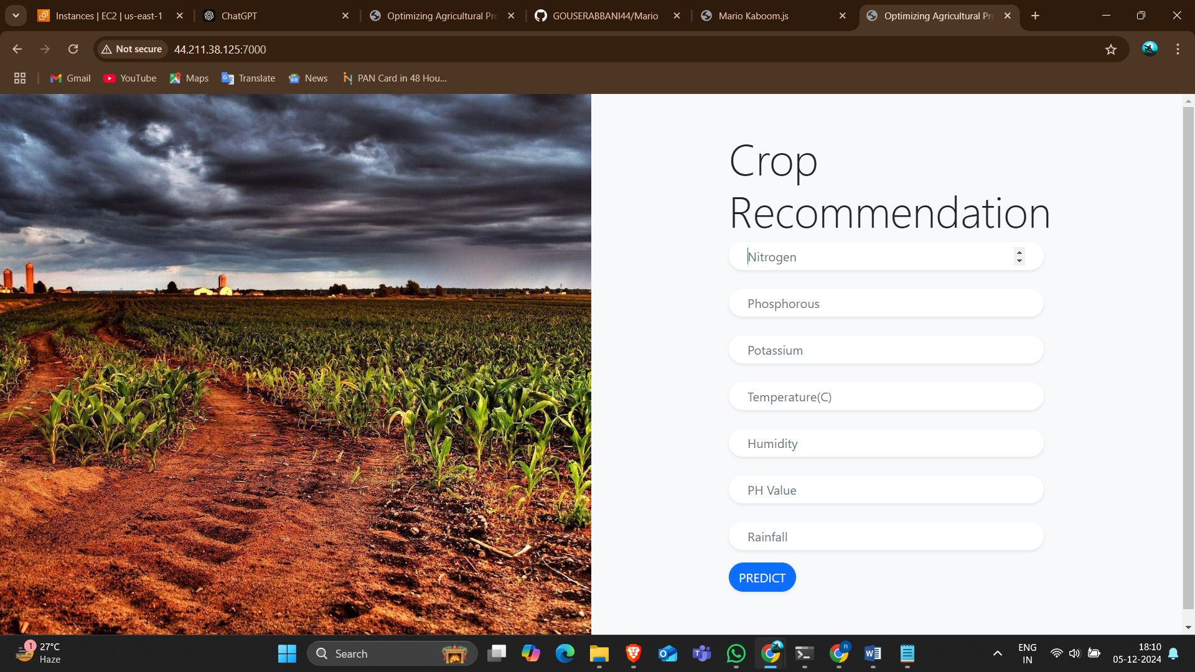
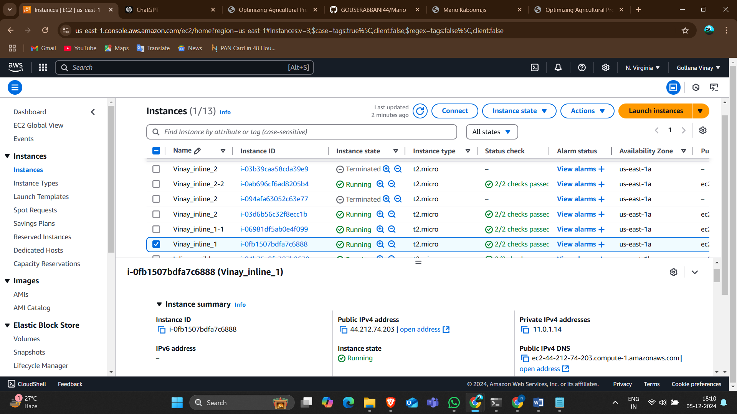
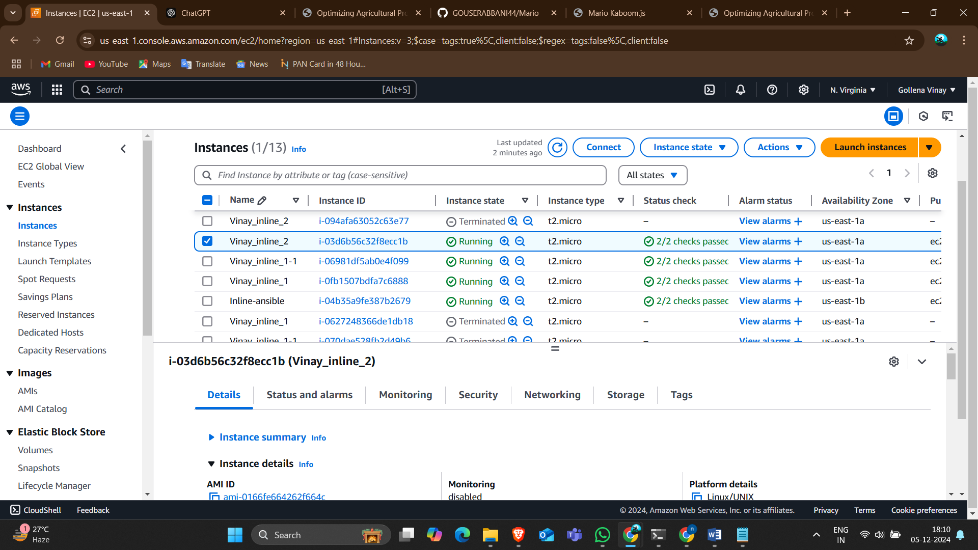
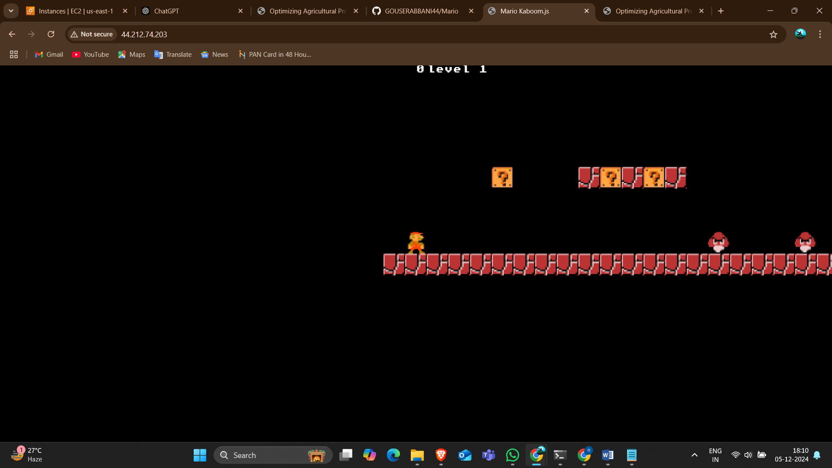

Slide 9
Method-3: Using Outline Variables
• Use external variable files (e.g., secret.yaml).
• Ideal for managing complex setups with sensitive data.
• Write separate playbooks for creating and deleting resources.

Slide 10
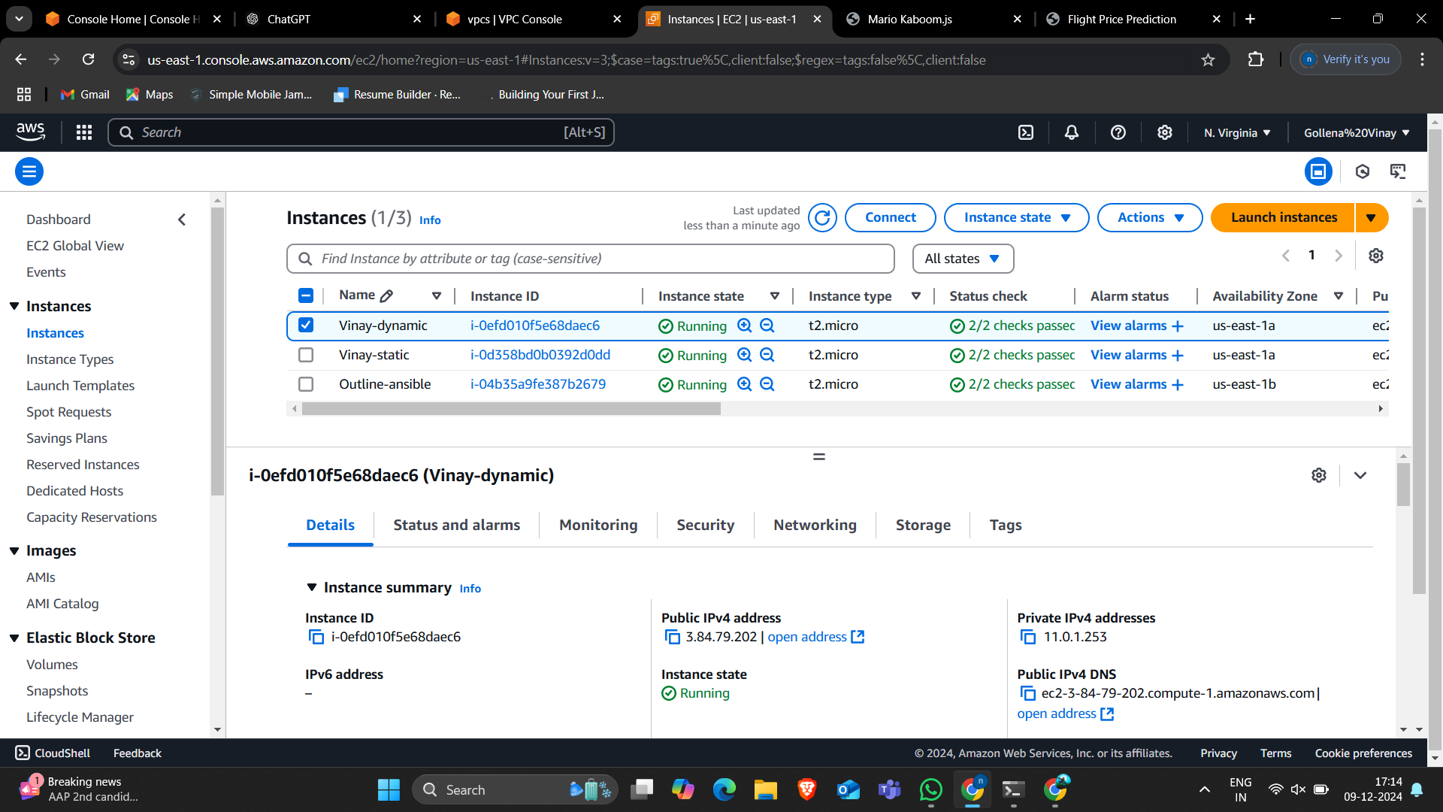
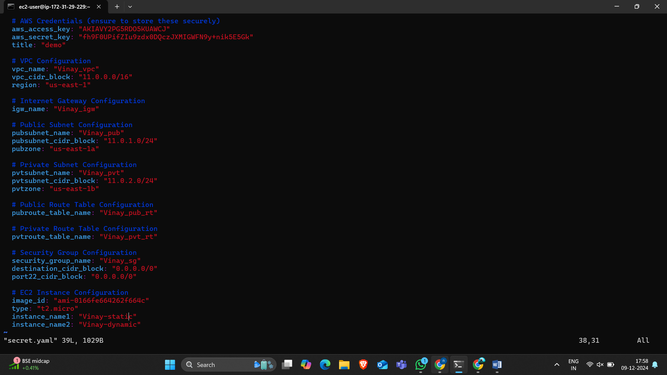


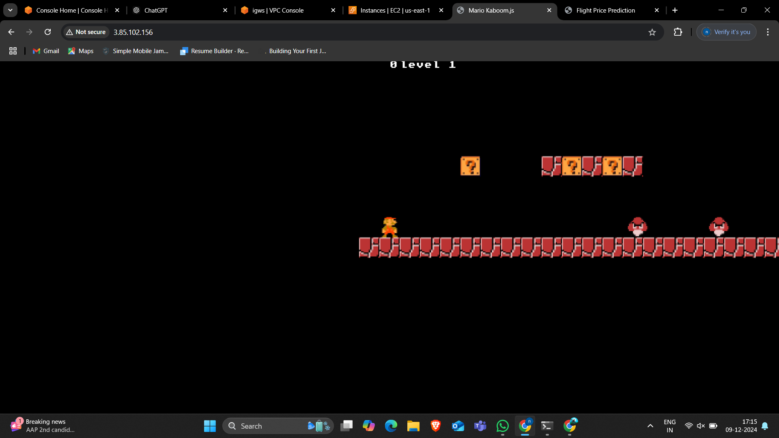
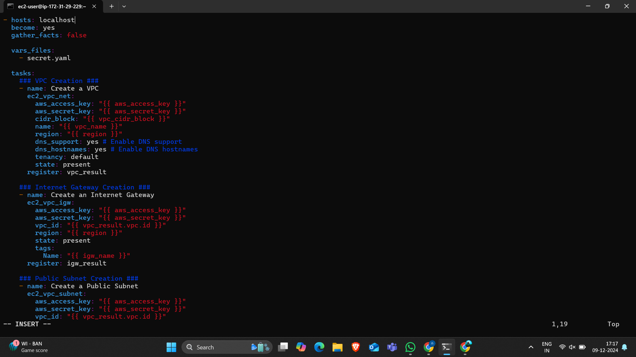
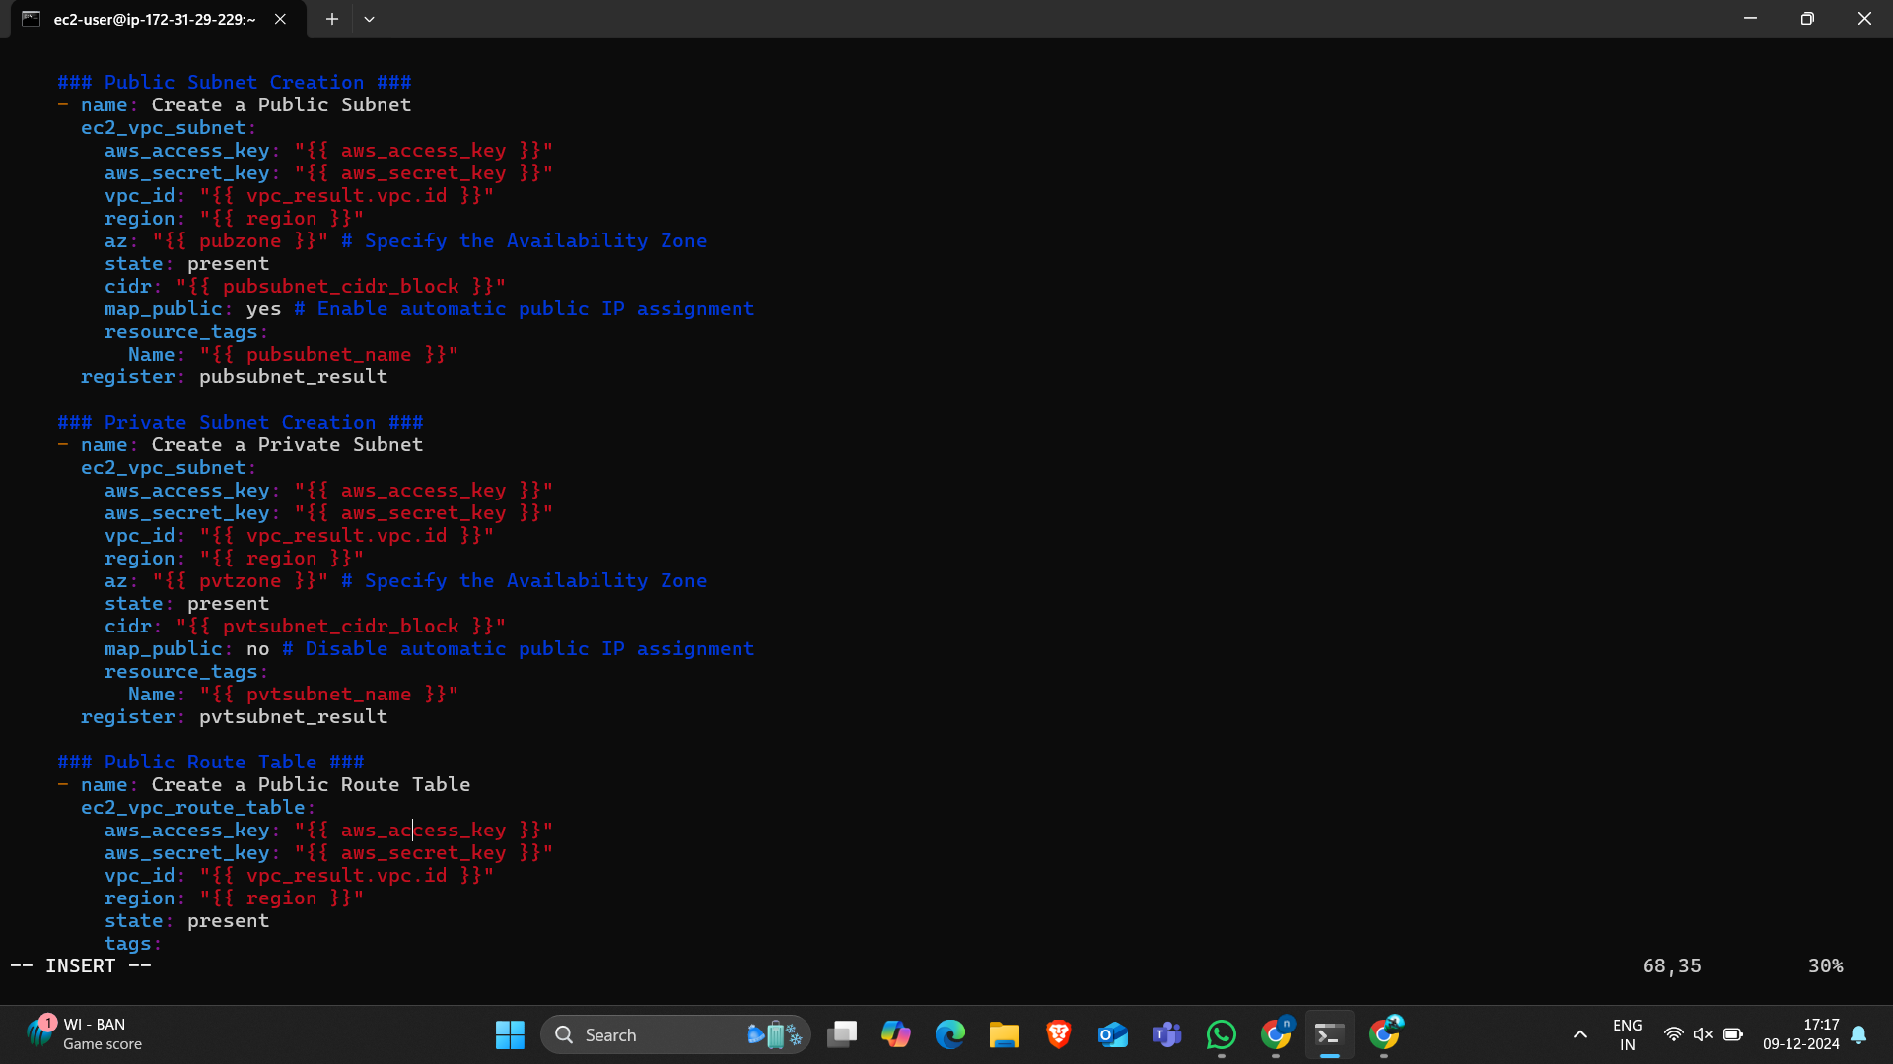
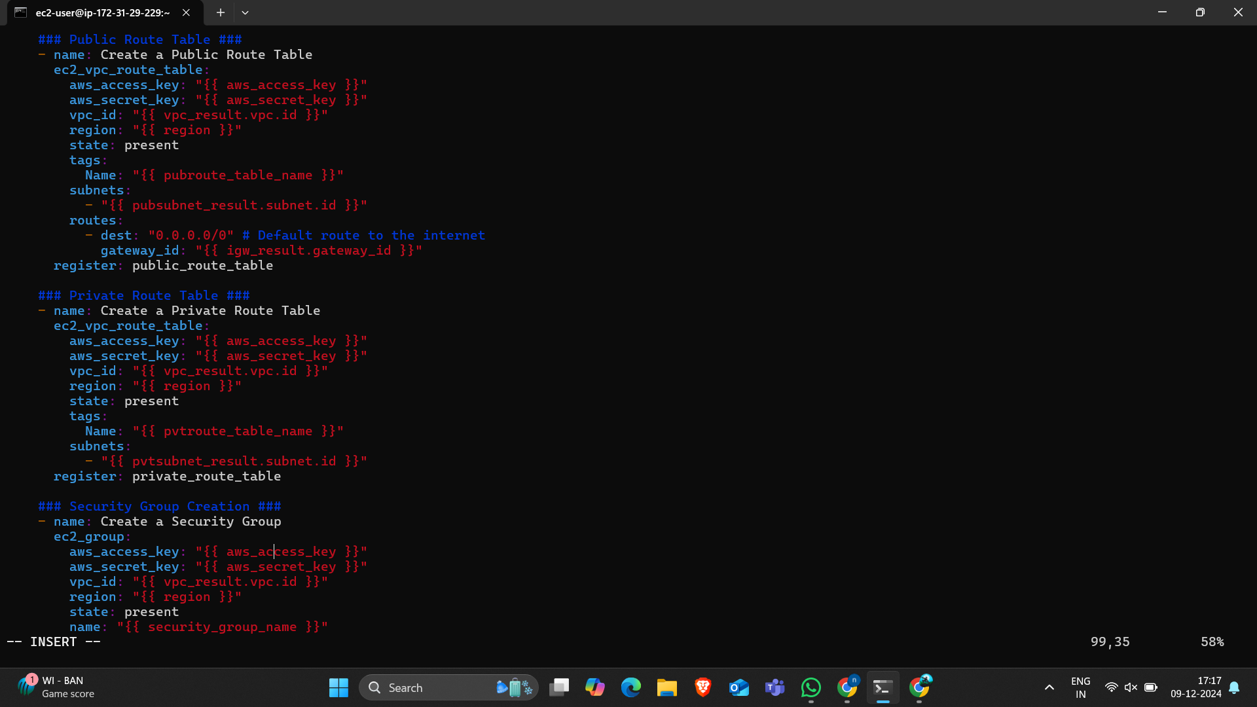
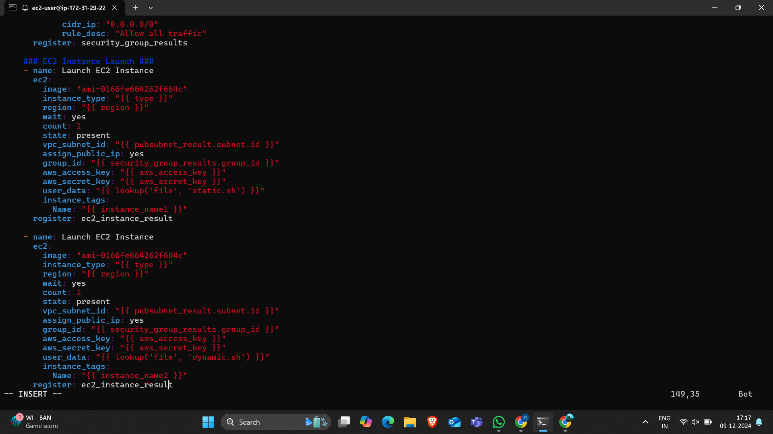

Slide 11
Resource Management and Deletion
• Manage AWS resources like:
- VPCs, Subnets, Route Tables, Internet Gateways.
• Write playbooks for deleting resources.
• Execute playbooks to clean up and release resources.

Slide 12
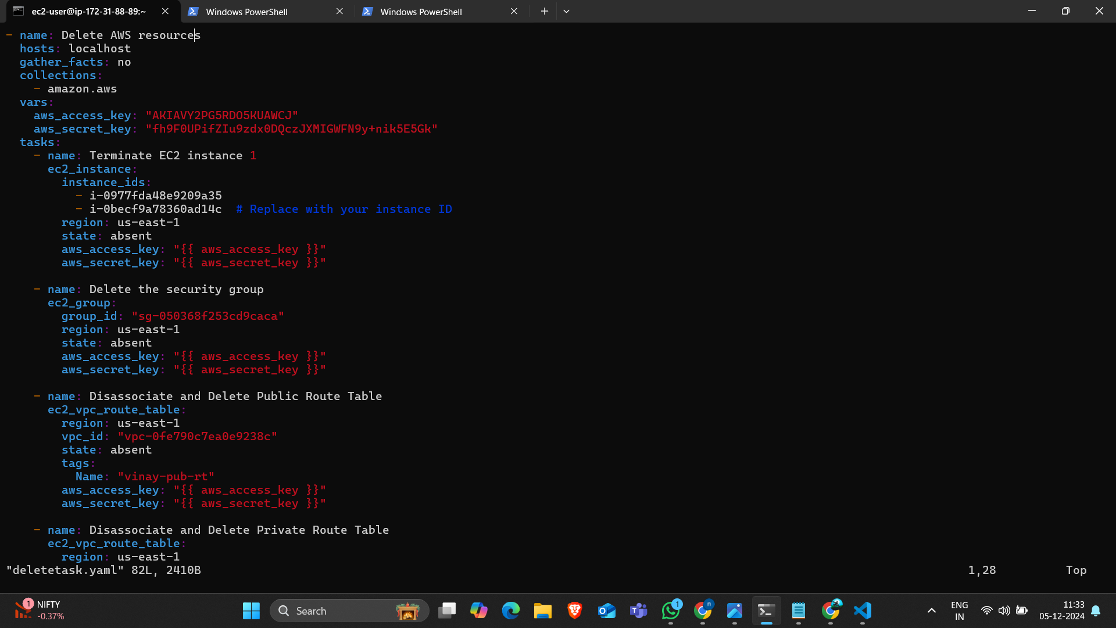
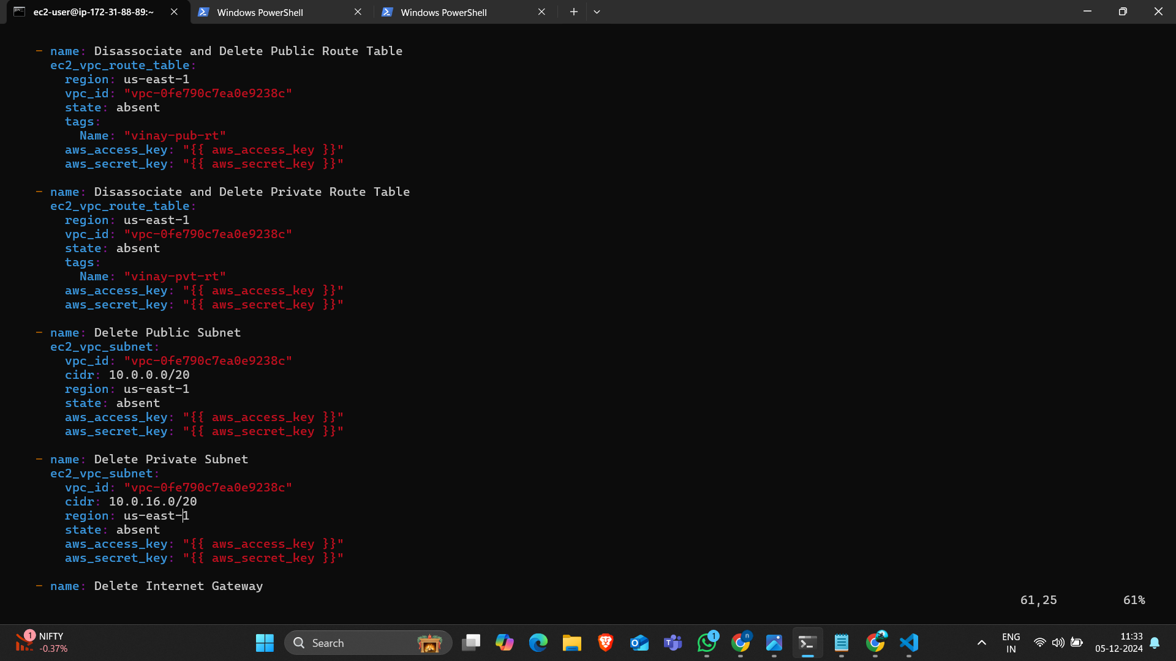
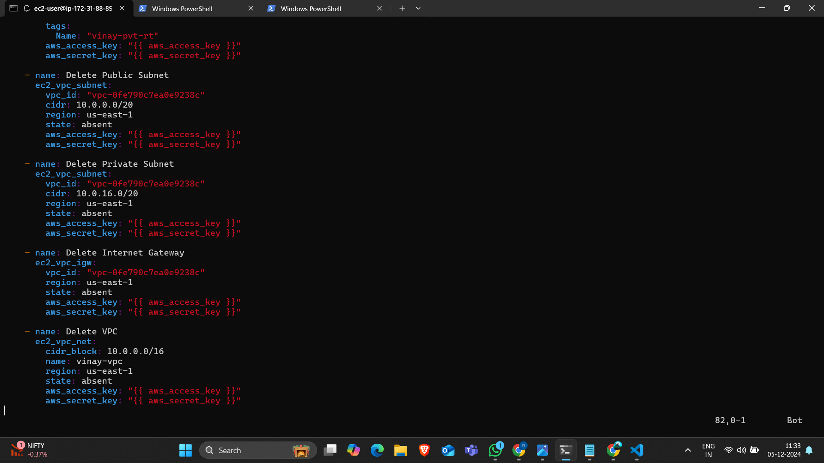
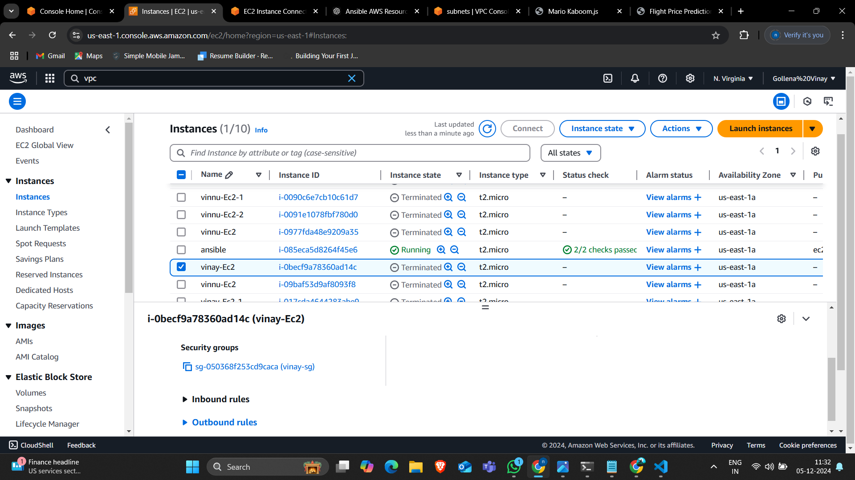
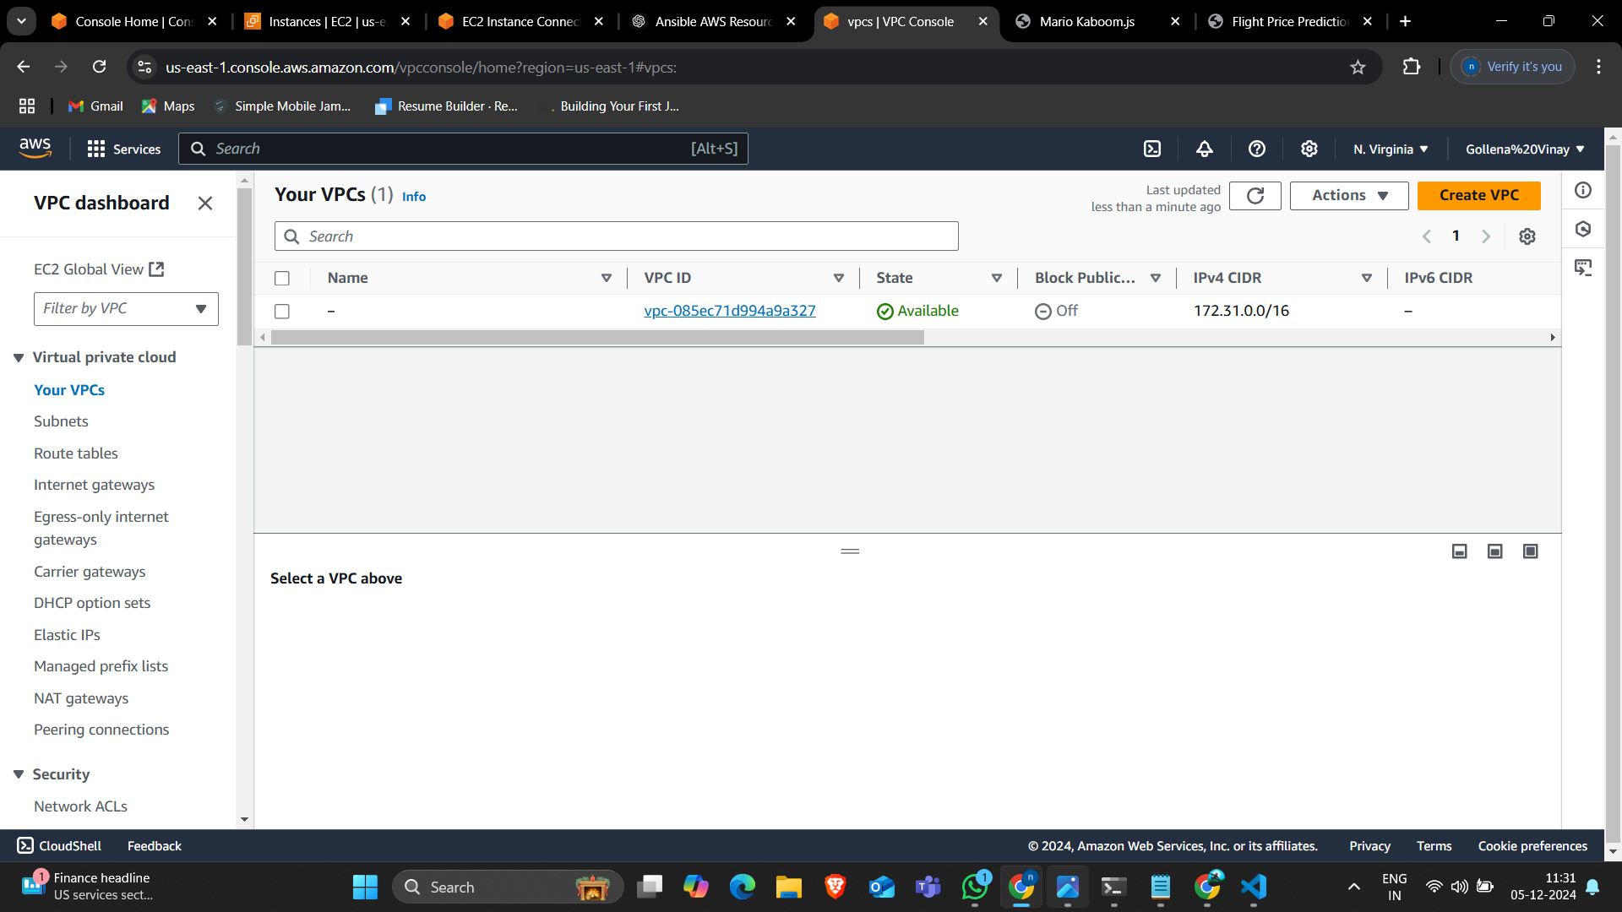
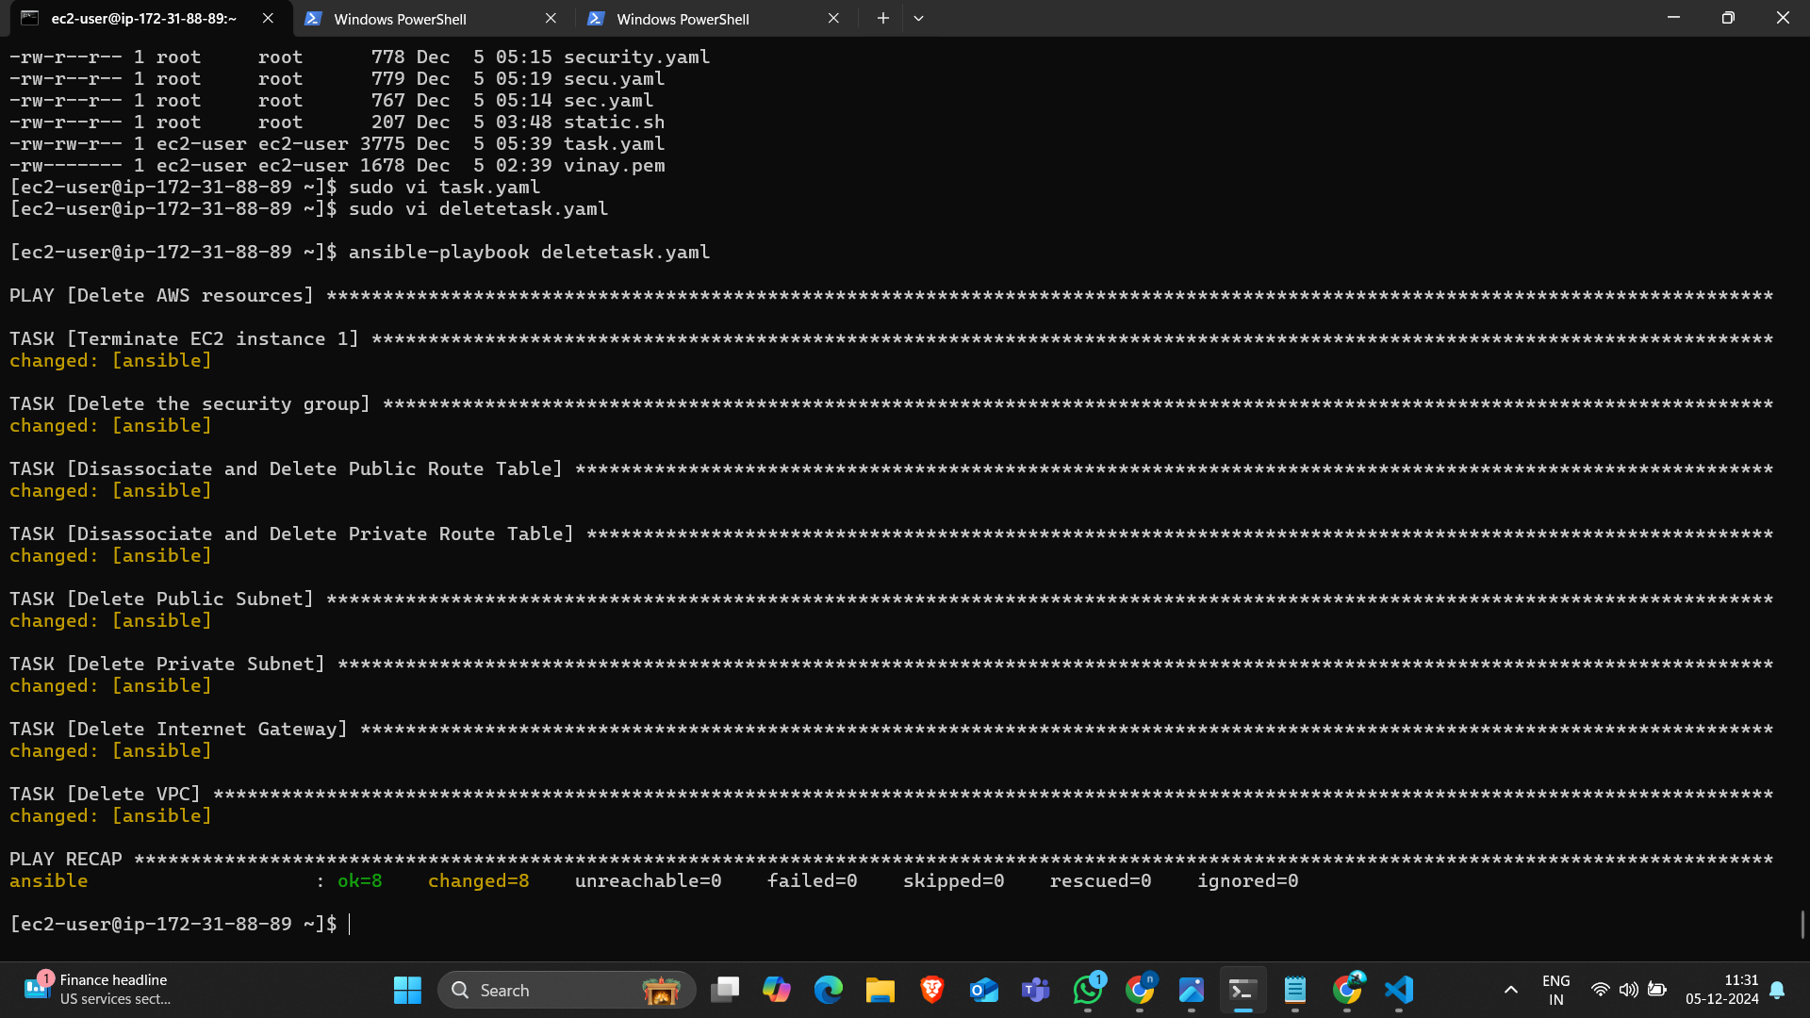

Slide 13
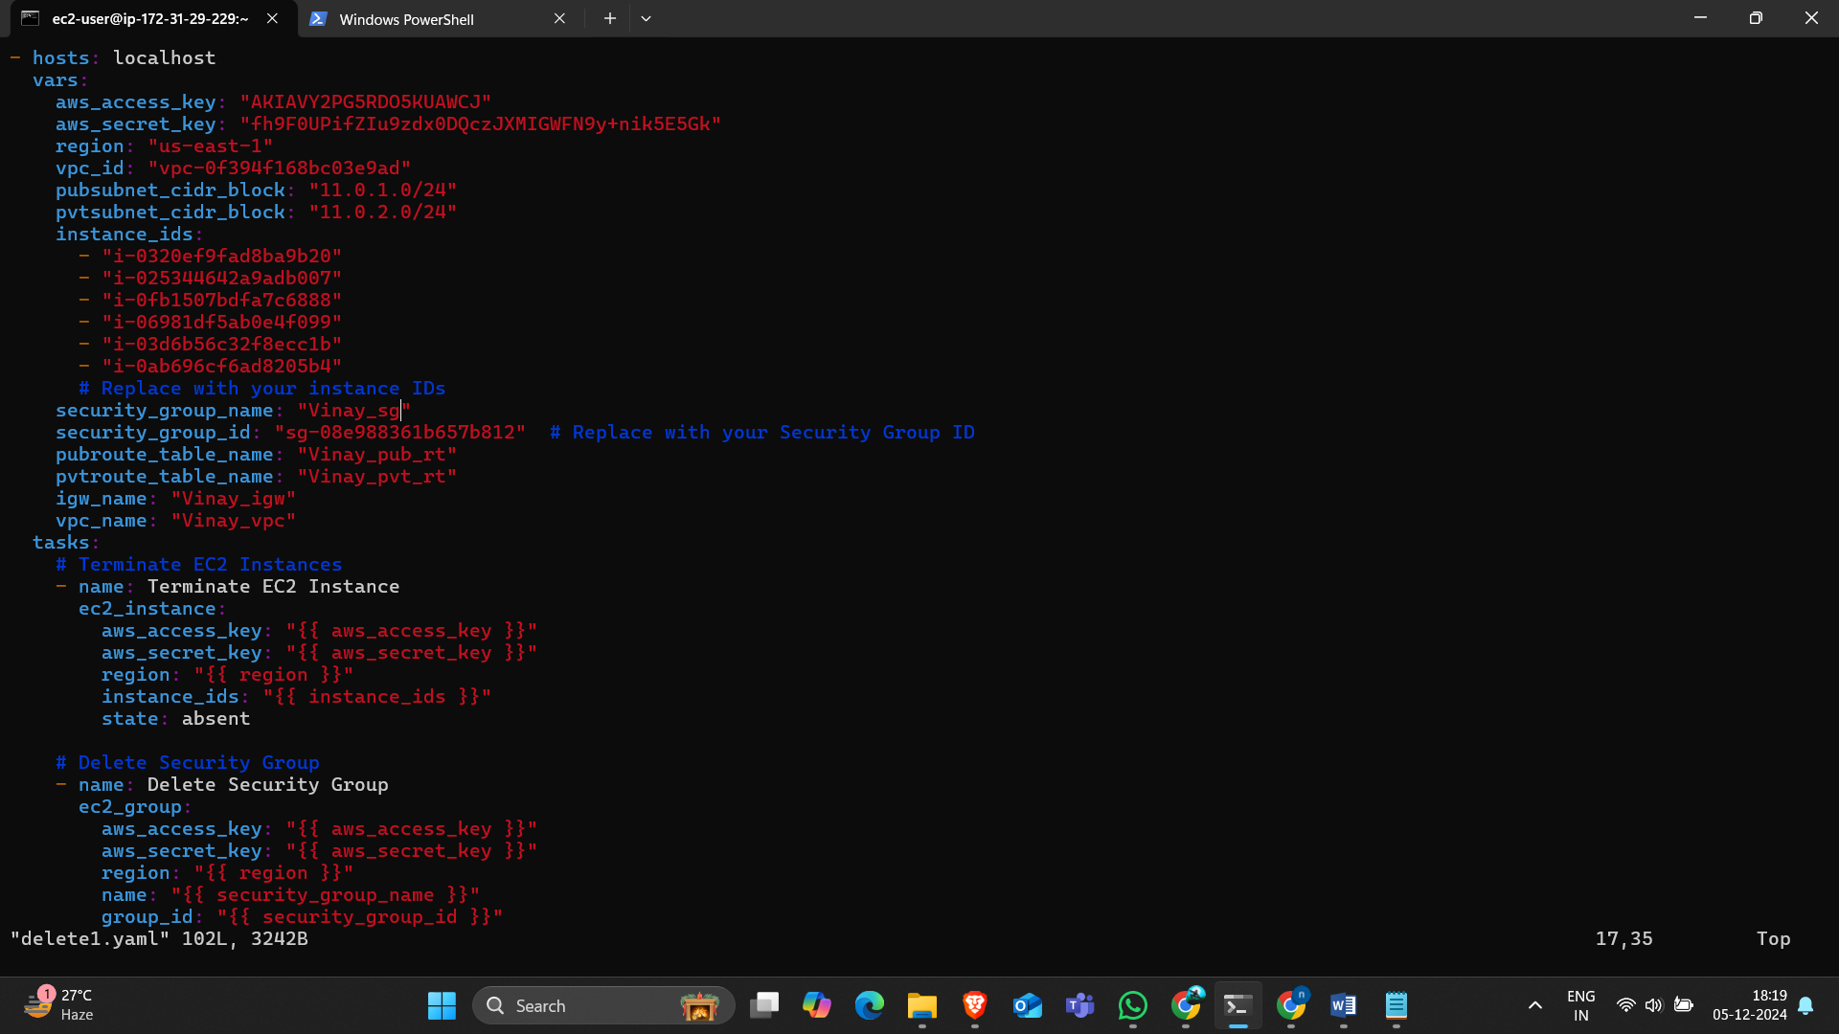
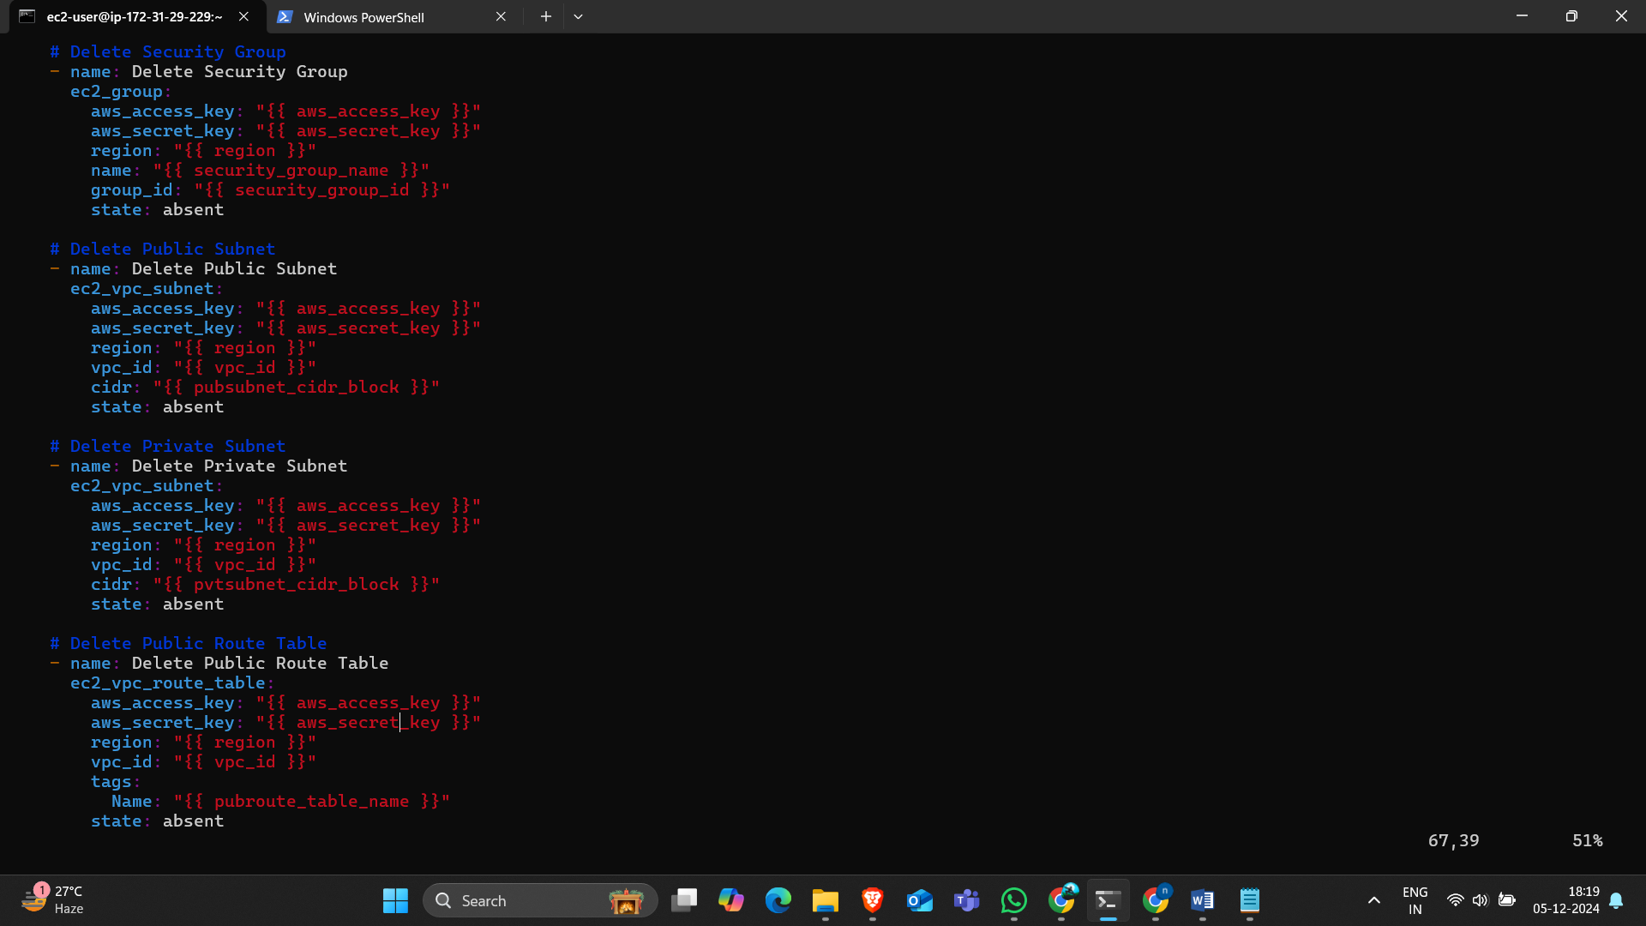
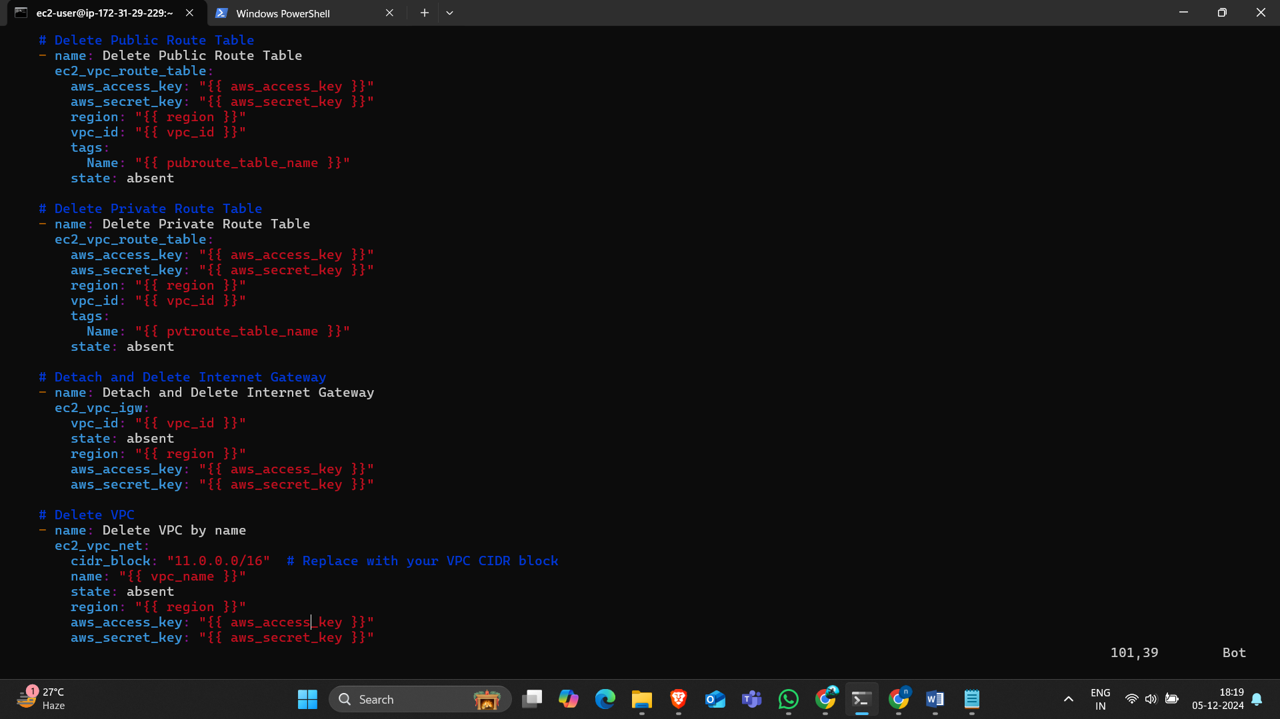
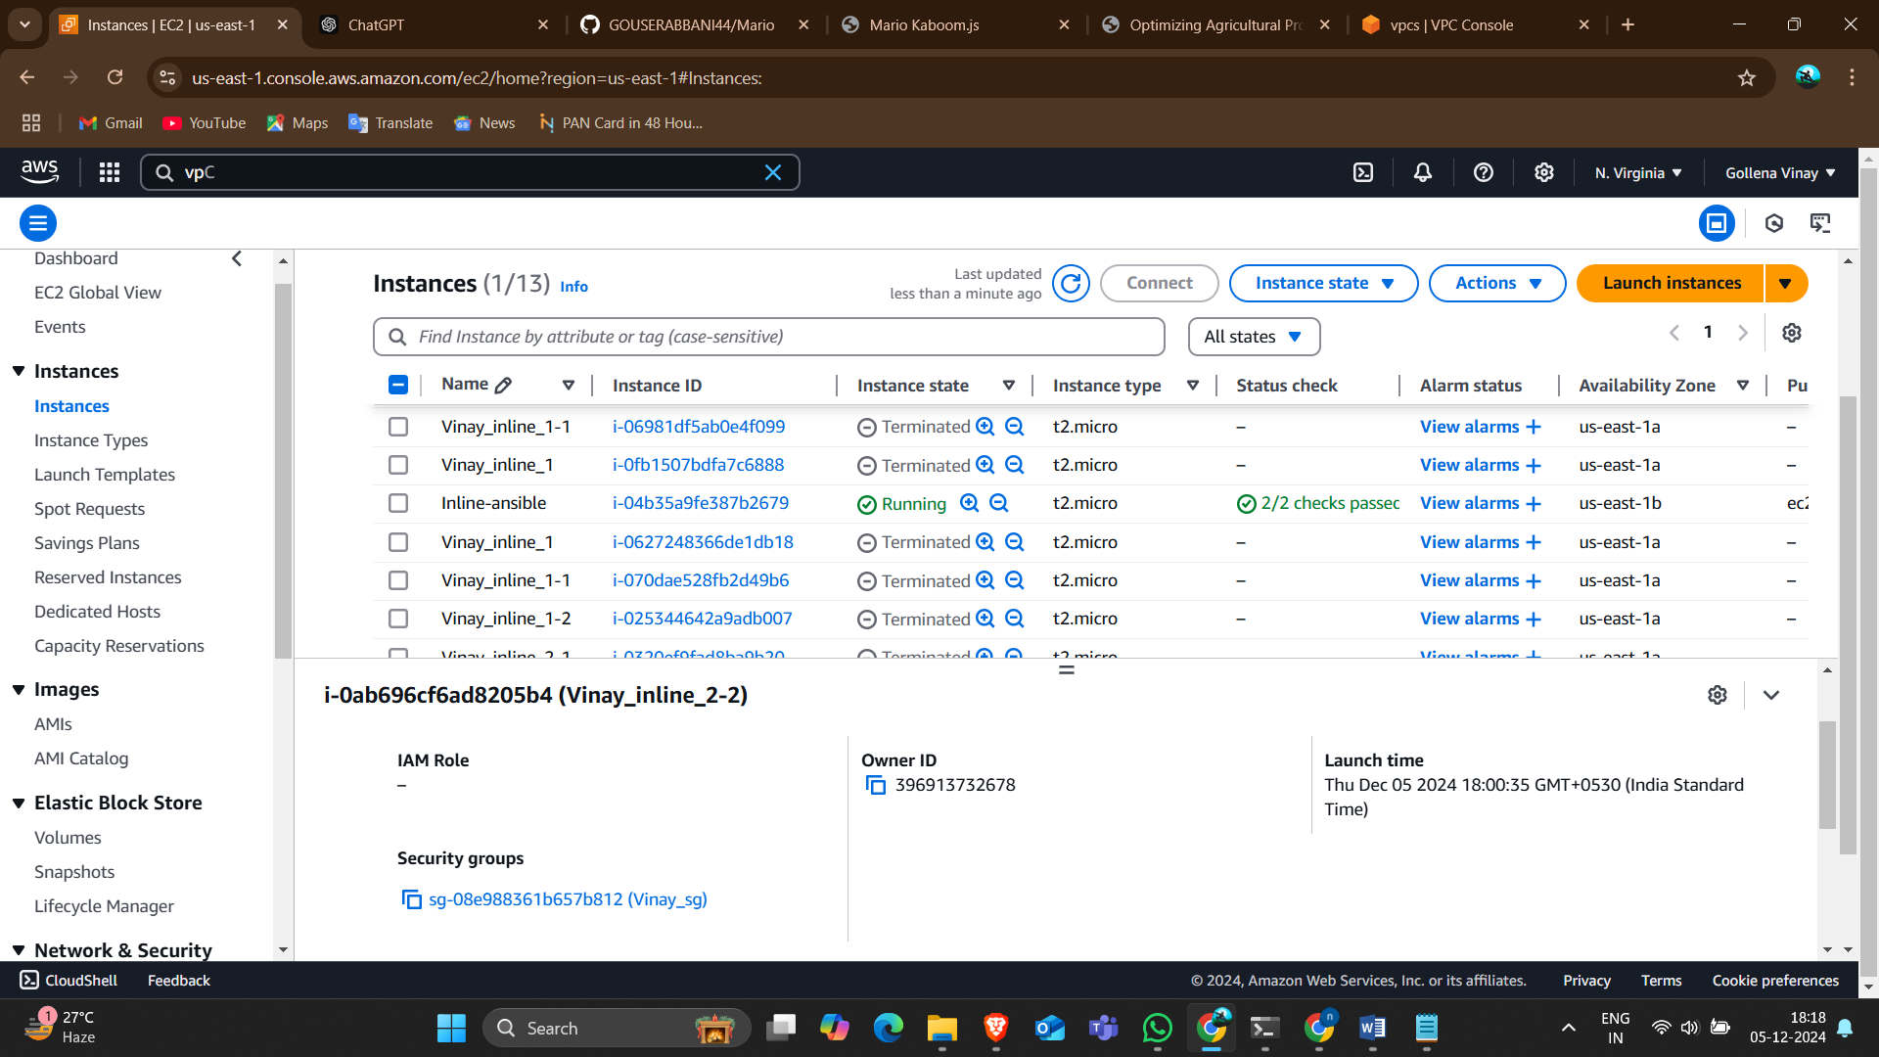
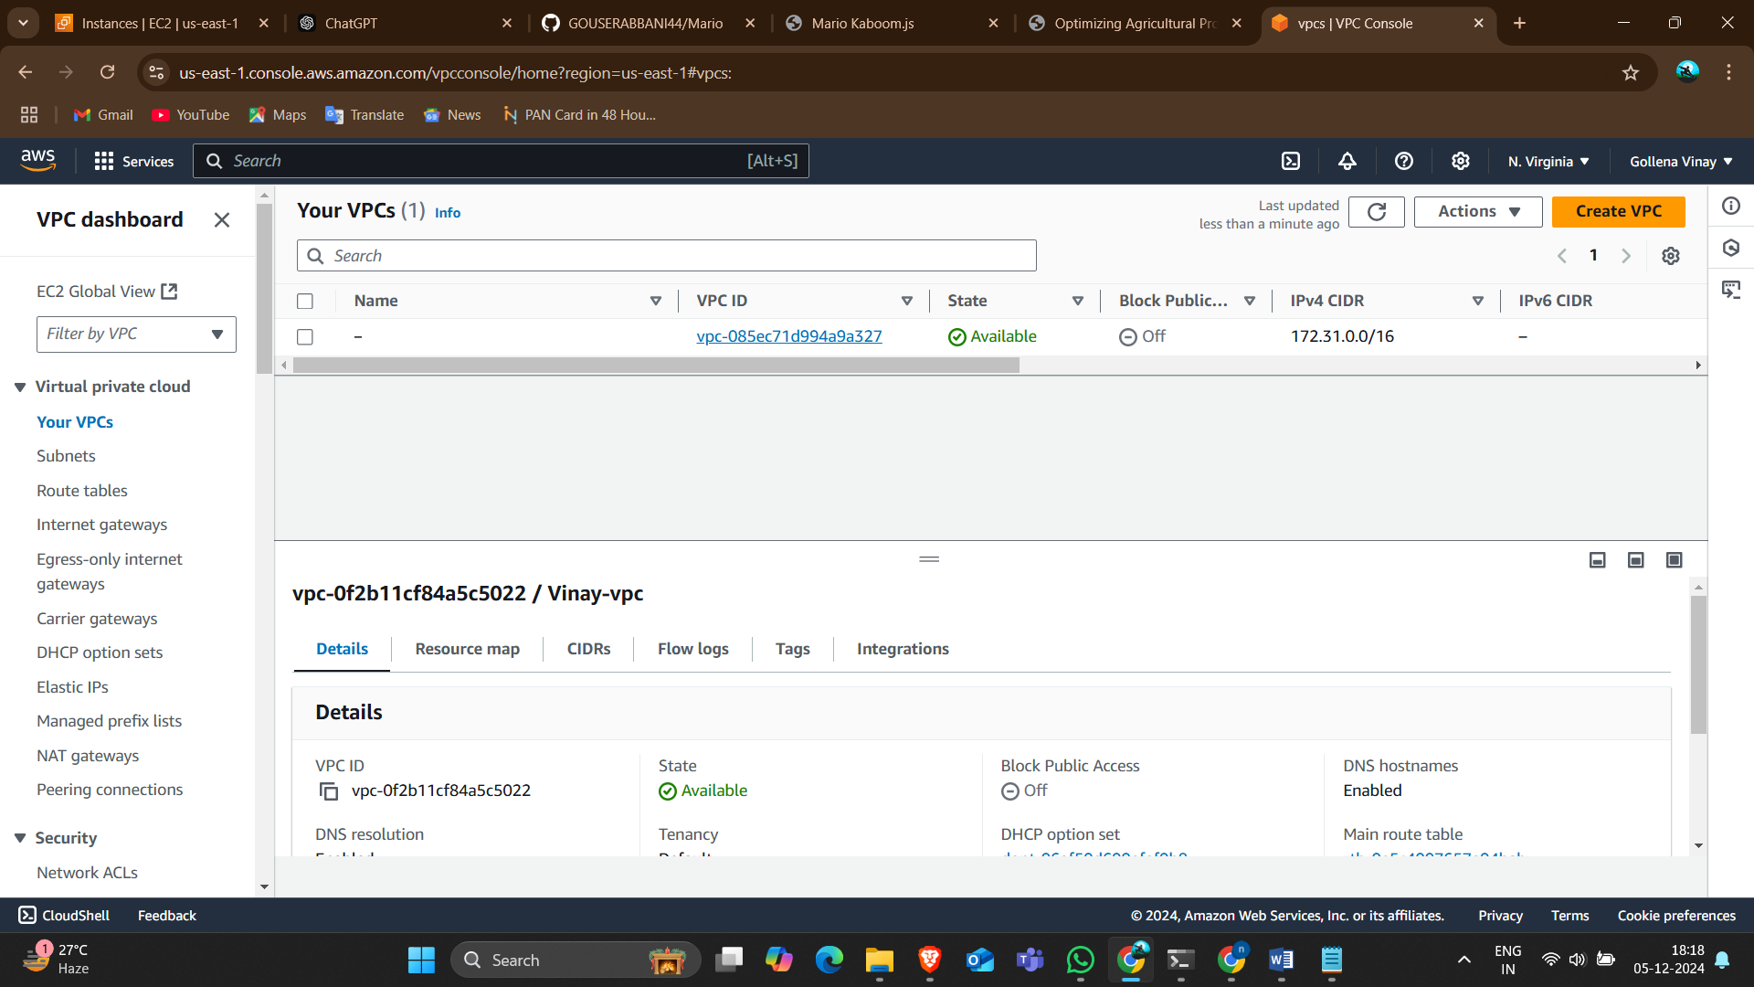
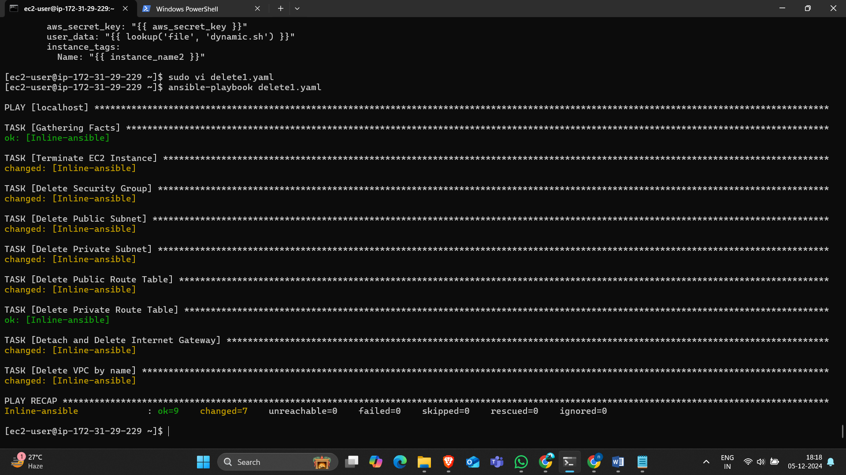
Inline deletion

Slide 14
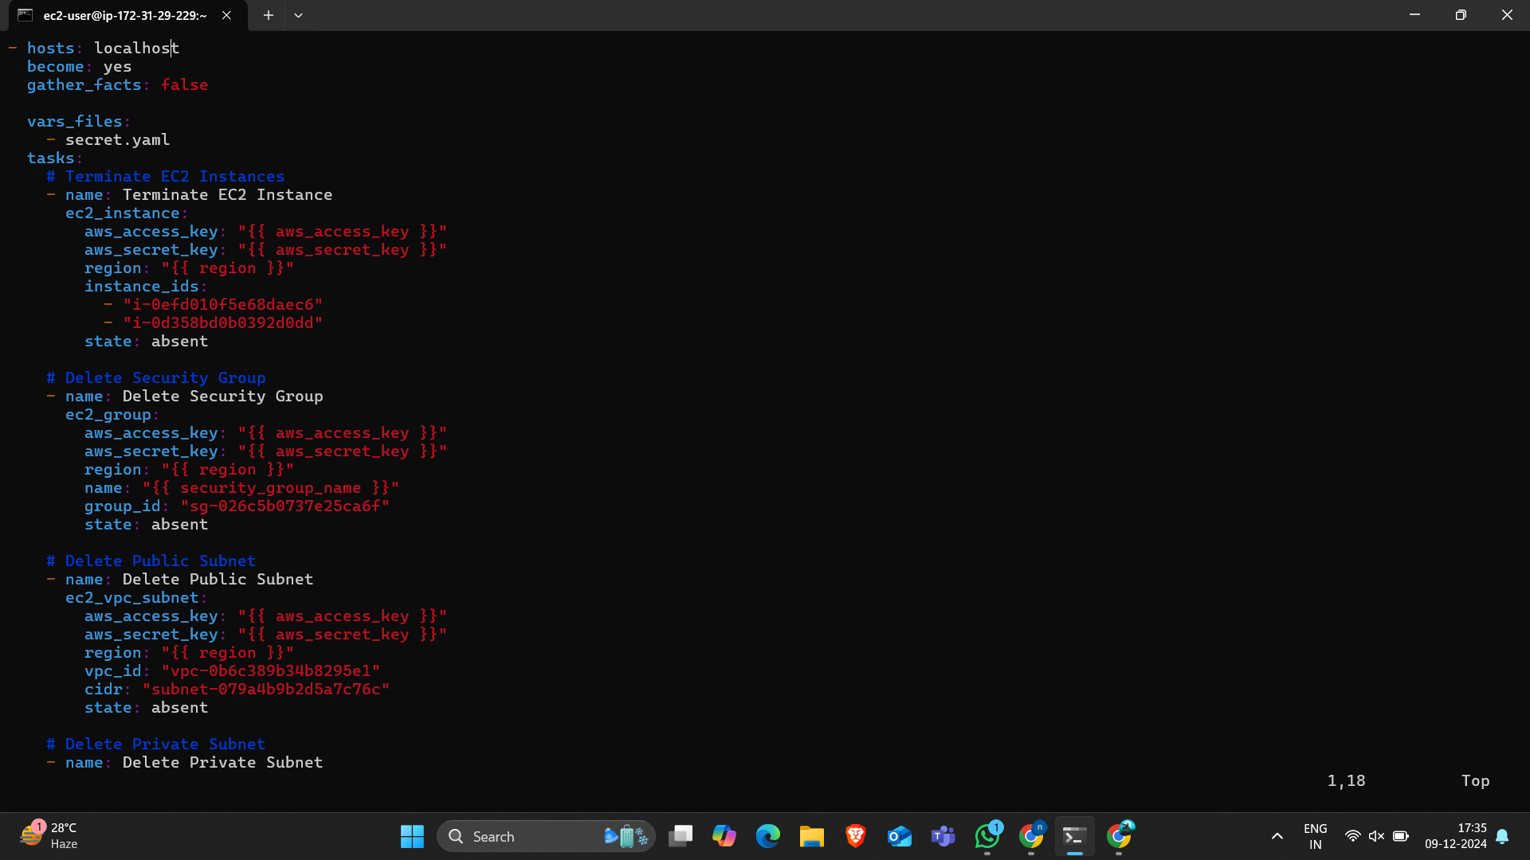
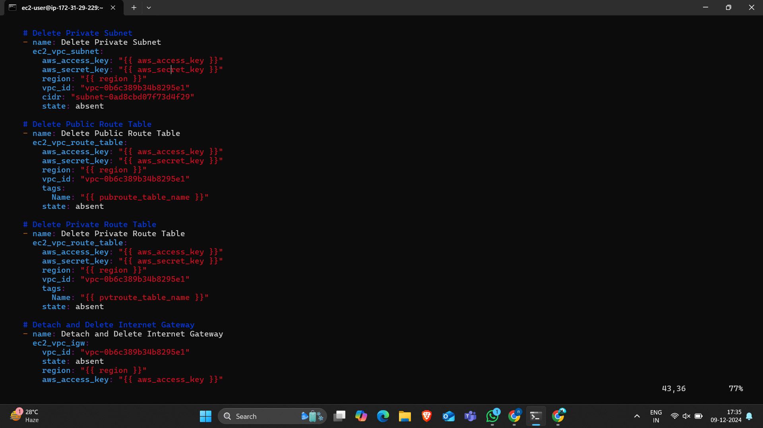
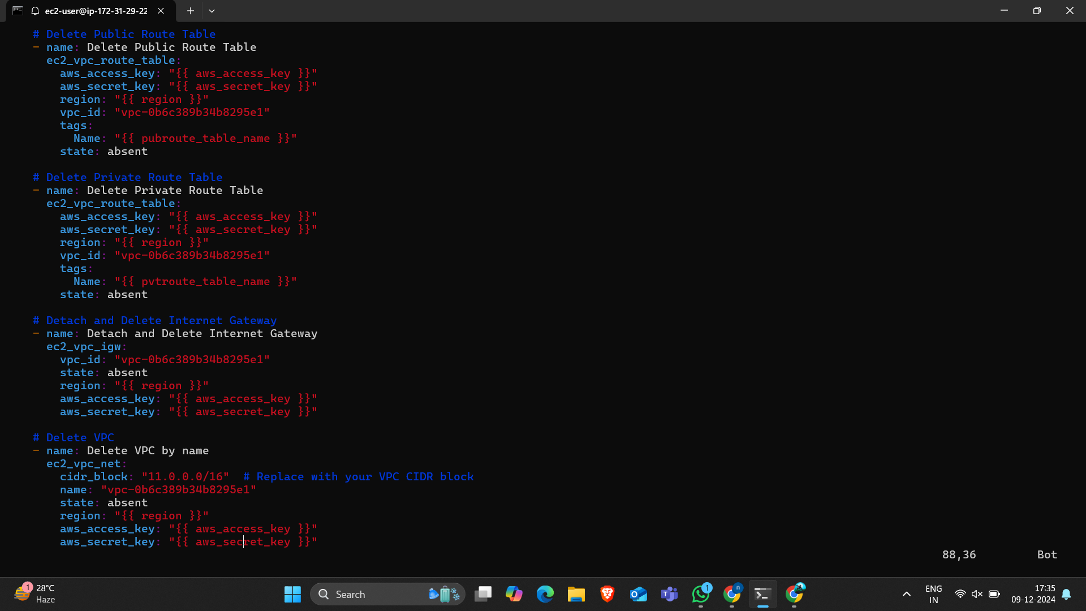
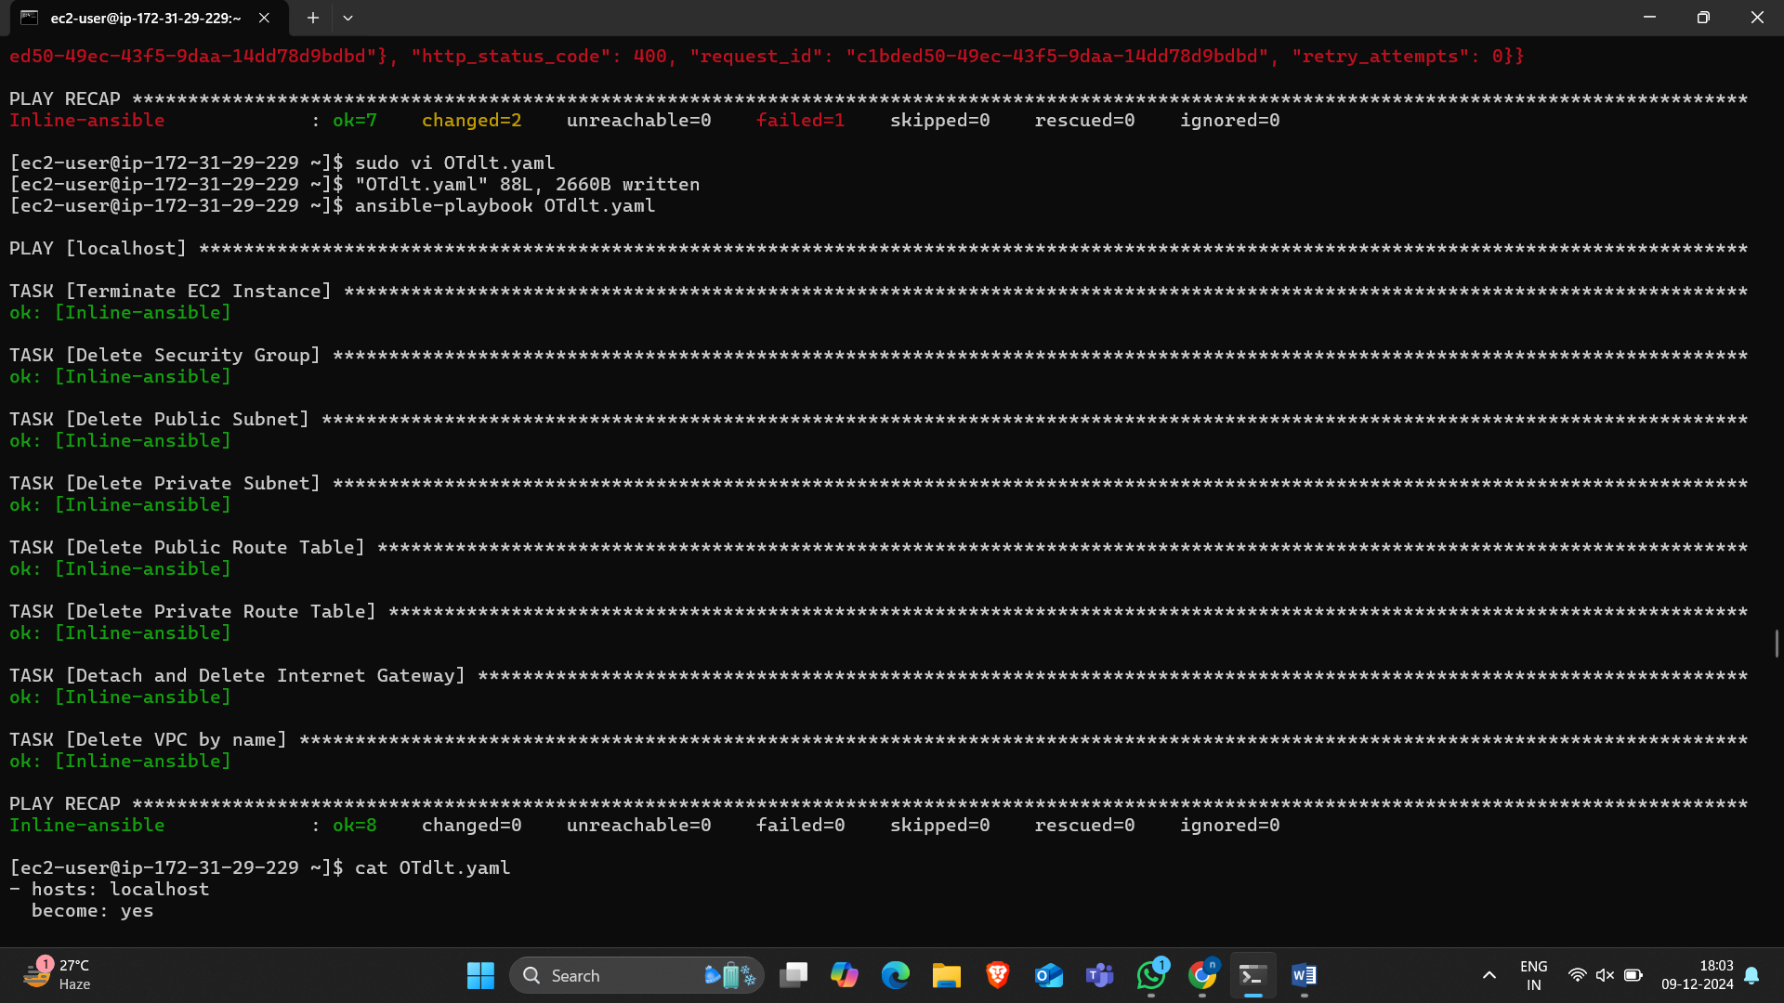
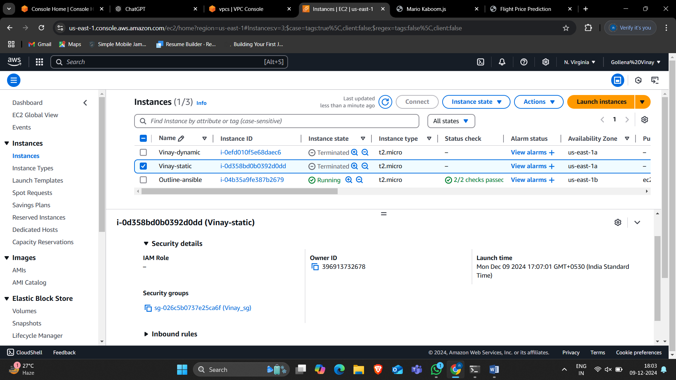
Outline deletion

Slide 15
Conclusion
• Ansible simplifies AWS resource management.
• Enables automated application deployment.
• Enhances efficiency and reduces manual effort.

Slide 16


